Slide 1

Exploring the Equilibrium in a Game with AI
Haijing Zhang

Slide 2
Table of Contents
Introduction of Game Theory
Challenges & Limitations
Game theory & Artificial Intelligence
Exploring Equilibrium Strategies in Network Games with Generative AI
Exploring the Equilibrium for Multi-stage Tournaments with reinforcement learning

Slide 3
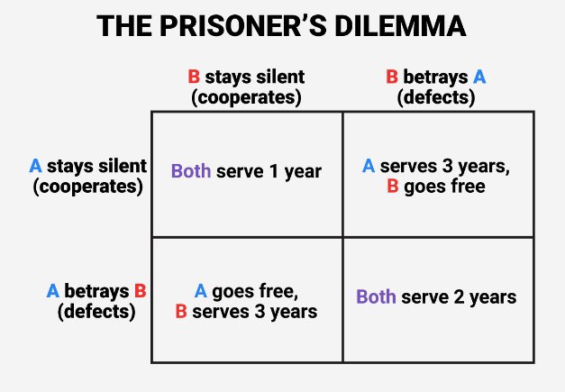
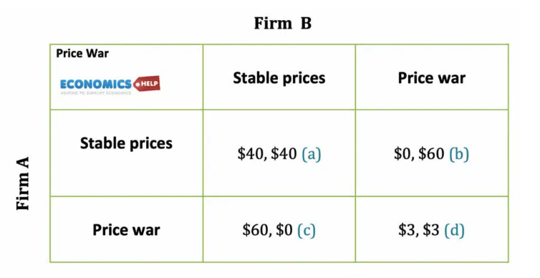
Introduction of Game Theory
Offer valuable insights into decision-making
Three main components: Players, actions/strategies and utility functions
https://www.sciencealert.com/a-professor-explains-how-1980s-game-theory-could-explain-how-morality-evolved
https://www.economicshelp.org/university/game-theory/

Slide 4
Challenges & Limitations
Finding an equilibrium solution of the game becomes harder
Analyzing strategic interactions in the game process is challenging
Traditional approach：
Limited participants and actions consideration
Standard game structure requirement.
Strong participant’s behavior assumption.

Slide 5
Game Theory & Artificial Intelligence
Discriminative AI:
Supervised learning
Reinforcement learning
...
Generative AI:
Offering the digital twin evolving environment
Creating AI agents to simulate the game process
Improving deep reinforcement learning for better decision-making performances

Slide 6
Exploring Equilibrium Strategies in Network Games with Generative AI
Y. Yang, H. Du, G. Sun, Z. Xiong, D. Niyato and Z. Han, "Exploring Equilibrium Strategies in Network Games with Generative AI," in IEEE Network, doi: 10.1109/MNET.2024.3521887.

Slide 7
Introduction
Objective: Machine learning model performance optimization against false data injection attack while minimizing costs
Collecting data for the object detection model: honest user, malicious user, different costs
A generative AI-enabled game theoretical framework: model formulation, solution derivation, and strategy evaluation.

Slide 8
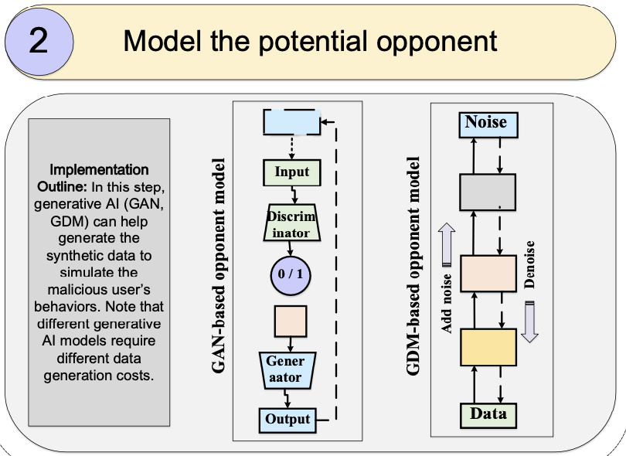
A Generative AI-enabled Game Theoretical Framework
Player: Honest user, GAN-based agent, and GDM-based agent.
Action: the number of data collected/generated by players
Utility function:
Malicious users: (SVM model accuracy - generation cost)
Honest users: SVM model accuracy - collection cost).
Strategies are guided by ChatGPT4

Slide 9
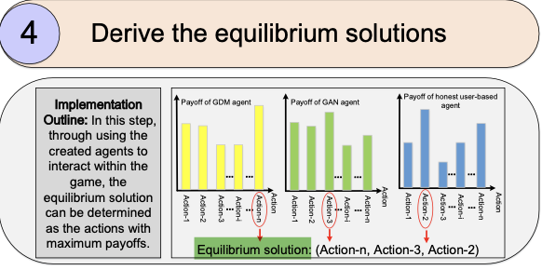
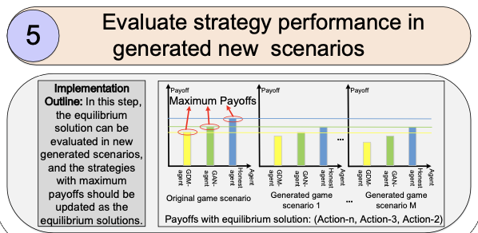
Exploring the Equilibrium
Baseline | Honest users | GAN-based agents | GDM-based agents
The number of images | 150 | 75 | 75
Data cost per image | 0.0005 | 0.0007 | 0.0008

Slide 10
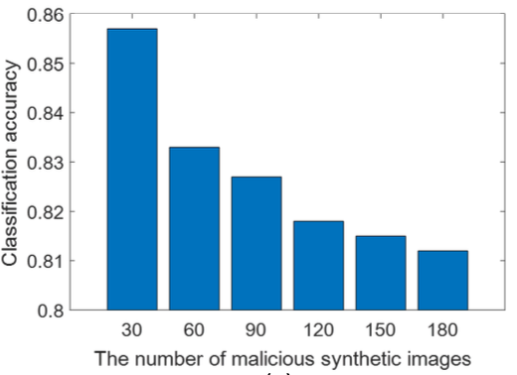
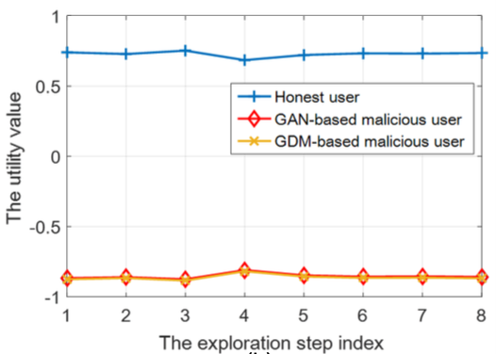
Result Analysis and Limitations
1- GAN and GDM can act as the attacker
2- The utilities can converge to a stable equilibrium strategy
3- The derived Nash equilibrium strategy remains optimal
4- Limitations: Scalability, the assumption of fixed datasets, methodology

Slide 11
Exploring the Equilibrium for Tournaments with Reinforcement Learning

Slide 12
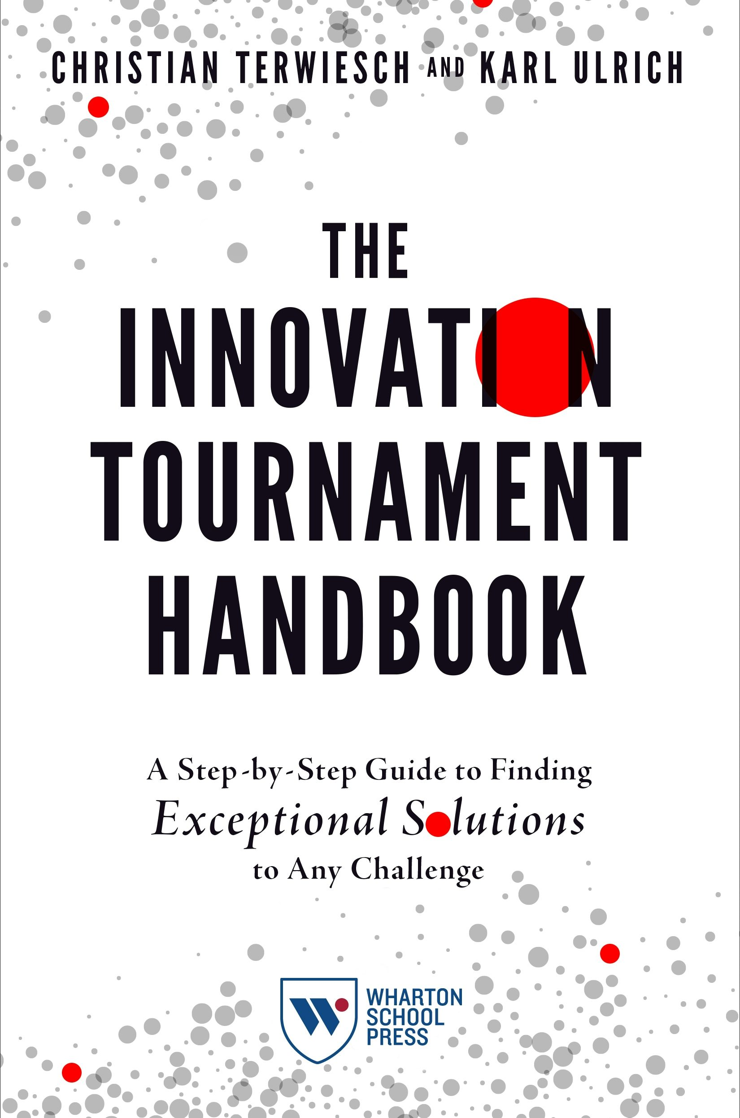
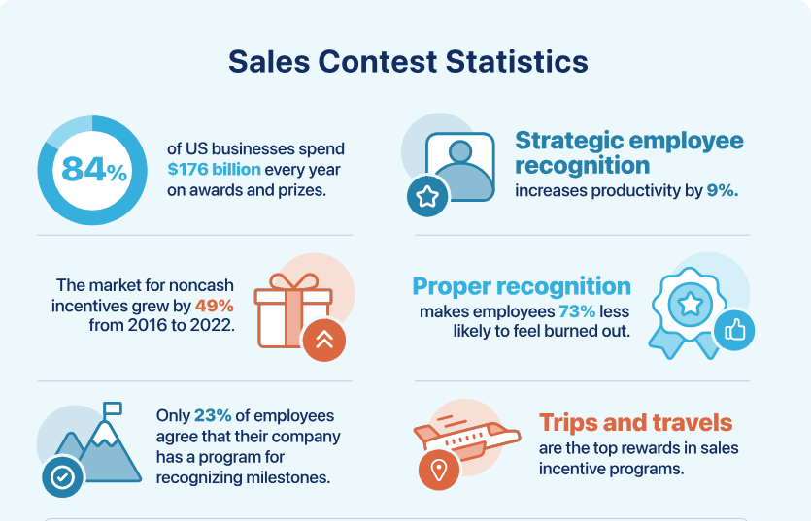
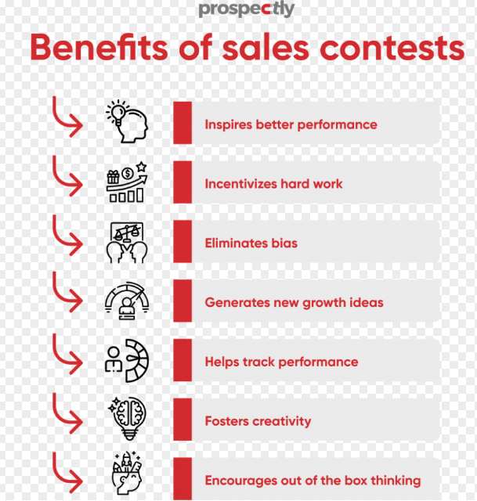
Research on Tournaments
https://fitsmallbusiness.com/sales-contest-ideas
https://www.prospectly.com/blog/17-elite-sales-contest-ideas/
https://knowledge.wharton.upenn.edu/article/how-innovation-tournaments-create-gargantuan-wins/

Slide 13
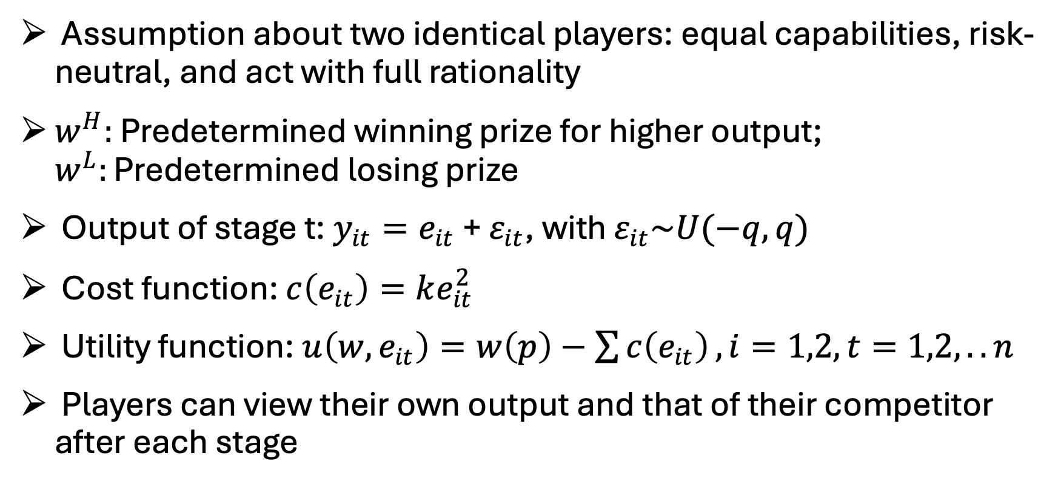
Tournament Model
Assumption about two identical players: equal capabilities, risk-neutral, and act with full rationality
$w^{H}:$ Predetermined winning prize for higher output; $w^{L}:\text{Predetermined} \text{losing} \text{prize}$
Output of stage t: $y_{it}=e_{it}$ + $ε_{it}$, with $ε_{it}\sim U(−q, q)$
Cost function: $c\left(e_{it}\right)=ke_{it}^{2}$
Utility function: $u\left(w,e_{it}\right)=w\left(p\right)−\sum{c\left(e_{it}\right)}, i=1,2,t=1,2,..n$
Players can view their own output and that of their competitor after each stage
Orrison, Alannah, Andrew Schotter, and Keith Weigelt. "Multiperson tournaments: An experimental examination." Management Science 50.2 (2004): 268-279.

Slide 14



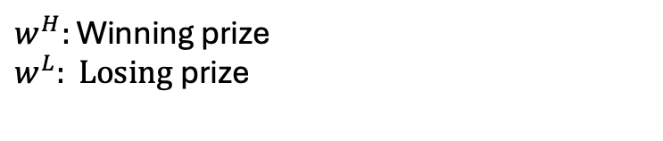

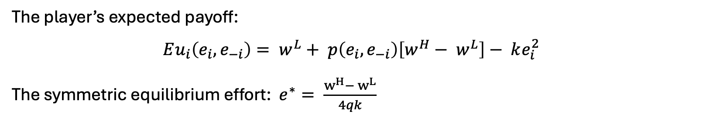




One-stage Tournament
$$e_{11}$$
$$ε_{11}$$
$$w^{L}$$
1
$$y_{11}$$
$w^{H}:$ Winning prize
$$w^{L}: \text{Losing} \text{prize}$$
$$e_{21}$$
$$ε_{21}$$
$$w^{H}$$
2
$$y_{21}$$
The player’s expected payoff:
$$Eu_{i}\left(e_{i}, e_{−i}\right)= w^{L}+ p\left(e_{i}, e_{−i}\right)\left[w^{H}− w^{L}\right]− ke_{i}^{2}$$
The symmetric equilibrium effort: $e^{∗}= \frac{w^{H}− w^{L}}{4qk}$
Orrison, Alannah, Andrew Schotter, and Keith Weigelt. "Multiperson tournaments: An experimental examination." Management Science 50.2 (2004): 268-279.

Slide 15


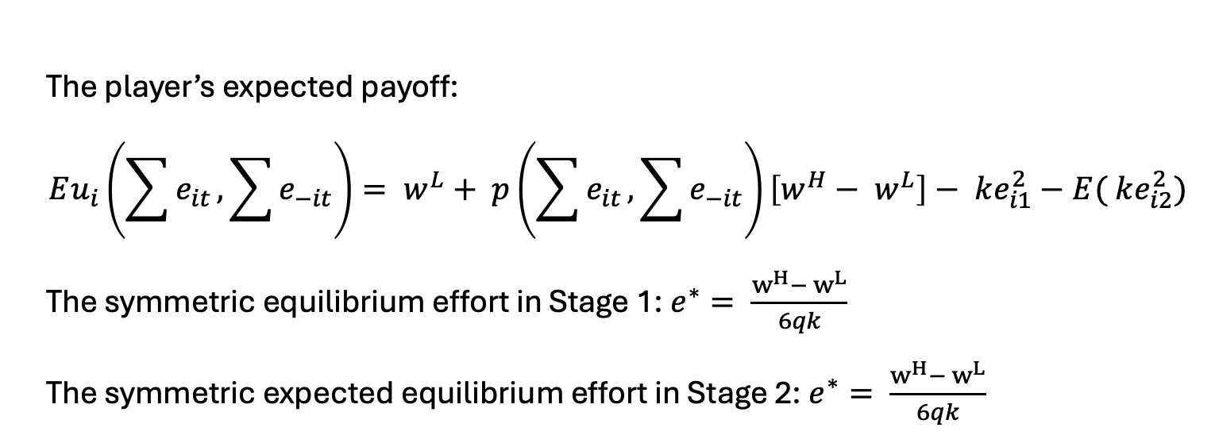






Two-stage Tournament
Stage 1
Stage 2
$$e_{11}$$
$$ε_{11}$$
$$e_{12}$$
$$ε_{12}$$
1
$$w^{L}$$
$$y_{11}$$
$$y_{12}$$
$$e_{21}$$
$$ε_{21}$$
$$e_{22}$$
$$ε_{22}$$
2
$$w^{H}$$
$$y_{21}$$
$$y_{22}$$
The player’s expected payoff:
$$Eu_{i}\left(\sum{e_{it}},\sum{e_{−it}}\right)= w^{L}+ p\left(\sum{e_{it}},\sum{e_{−it}}\right)\left[w^{H}− w^{L}\right]− ke_{i1}^{2}−E( ke_{i2}^{2})$$
The symmetric equilibrium effort in Stage 1: $e^{∗}= \frac{w^{H}− w^{L}}{6qk}$
The symmetric expected equilibrium effort in Stage 2: $e^{∗}= \frac{w^{H}− w^{L}}{6qk}$

Slide 16




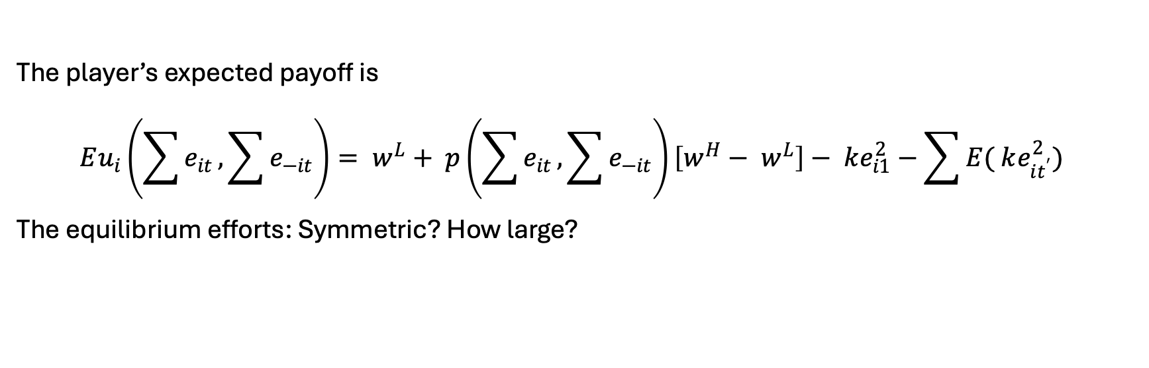














Multi-Stage Tournament
Stage 1
Stage 2
Stage t
$$e_{11}$$
$$ε_{11}$$
$$e_{12}$$
$$ε_{12}$$
$$e_{1t}$$
$$ε_{1t}$$
$$w^{L}$$
1
…
$$y_{11}$$
$$y_{12}$$
$$e_{21}$$
$$ε_{21}$$
$$e_{22}$$
$$ε_{22}$$
$$e_{2t}$$
$$ε_{2t}$$
2
…
$$w^{H}$$
$$y_{21}$$
$$y_{22}$$
The player’s expected payoff is
$$Eu_{i}\left(\sum{e_{it}},\sum{e_{−it}}\right)= w^{L}+ p\left(\sum{e_{it}},\sum{e_{−it}}\right)\left[w^{H}− w^{L}\right]− ke_{i1}^{2}−\sum{E( ke_{it^{′}}^{2})}$$
The equilibrium efforts: Symmetric? How large?

Slide 17

Motivation
Learn to find the equilibrium in the tournament with AI techniques
Valuable insight in research and practice
Proving equilibrium for the tournaments with more than two stages remains a significant challenge

Slide 18
Objectives
Train the model to learn how to find the equilibrium: one stage and two stages
Without data
With limited data
Multi-stage tournament
Exploring the effort equilibrium for more than three stages
Insights for proving the equilibrium, incentive strategies

Slide 19
Methodology
Reinforcement learning: Finding the equilibrium
Trial-and-Error learning
Adaptability in dynamic environments
Multi-agent interactions
Scalability
Reward function = Utility function

Slide 20

Thank you!

